Slide 1
Cost Of Living Project
Under Mentorness Internship Program
Date: 30/05/2024
Name: Manoj Prajapati

Slide 2
Problem Statement
What are the cities and countries with the highest and lowest costs of living?
What are the major cost components contributing to the overall cost of living in a region?
How do factors like average salary, housing costs, and transportation expenses correlate with the cost of living?
Are there any trends or patterns in the data that can help individuals and organizations make strategic decisions?

Slide 3
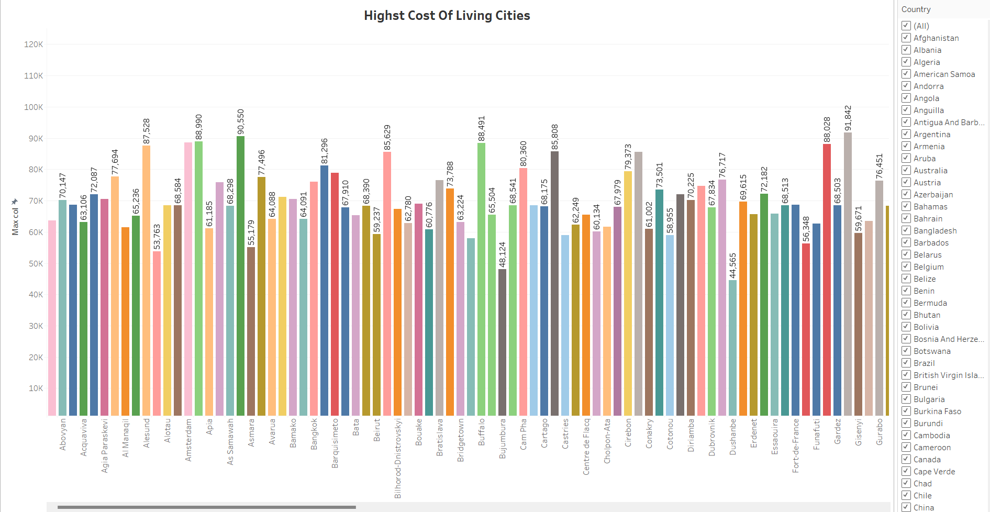
Highest Cost of living of Each Country

Slide 4
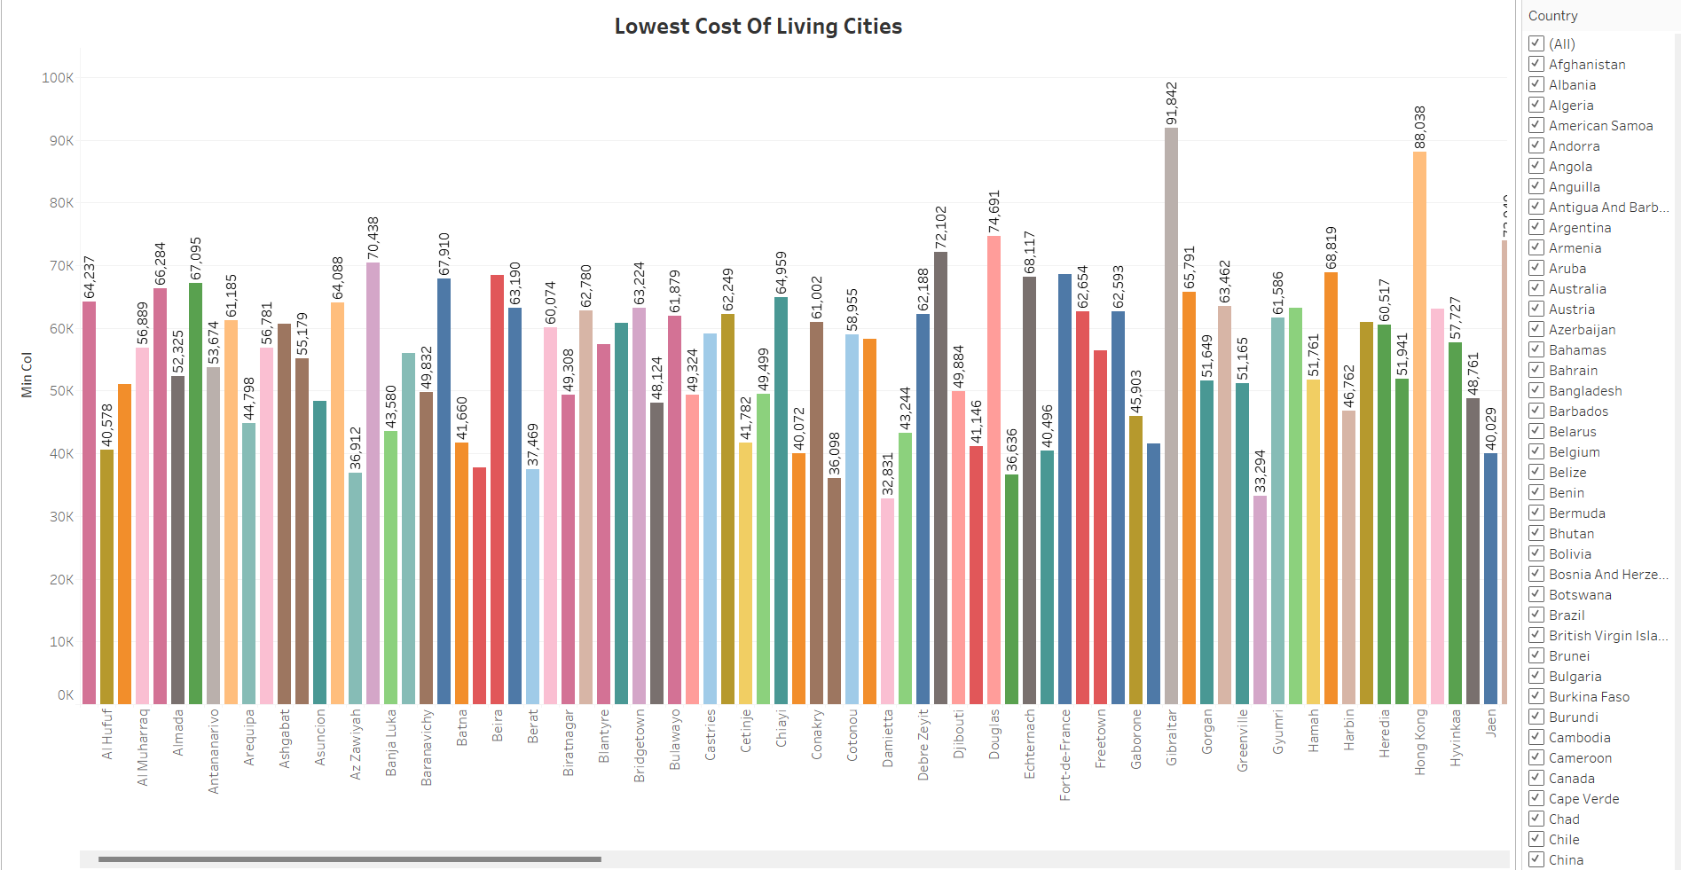
Lowest Cost of living of Each Country

Slide 5
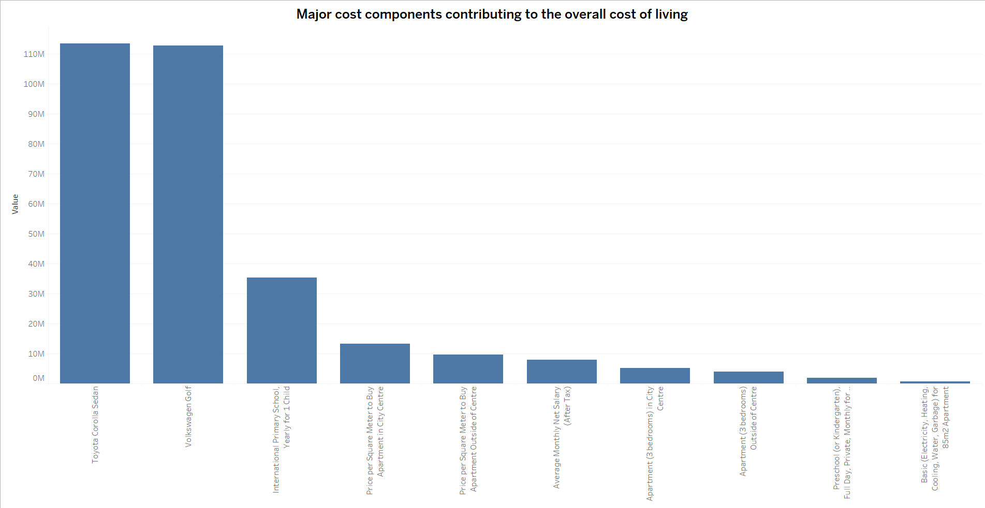
Major Cost Component who is Contributing to Overall Cost of Living

Slide 6
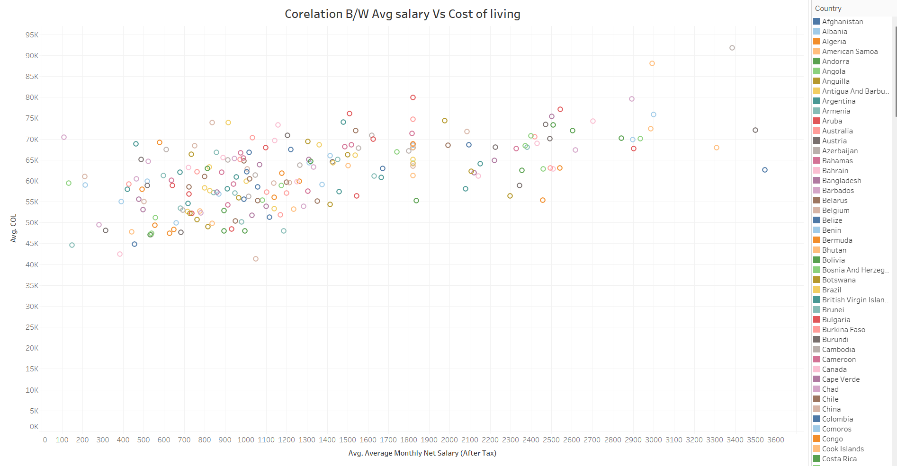
Correlation B/W Avg. Salary & Cost Of Living

Slide 7
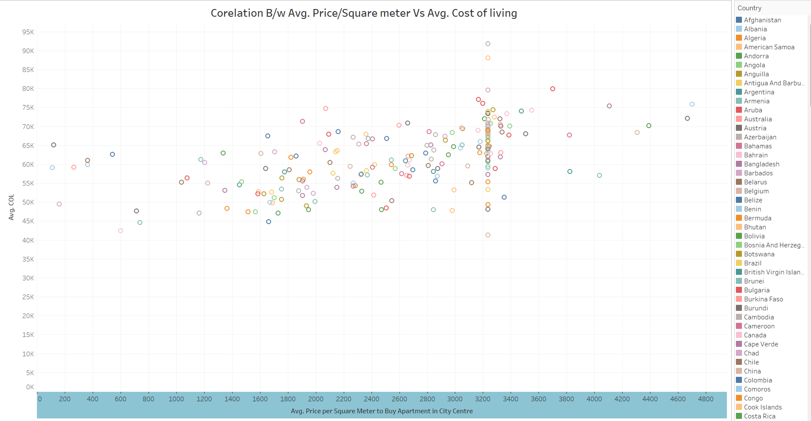
Correlation B/W Avg. Price/Square meter & Cost Of Living

Slide 8
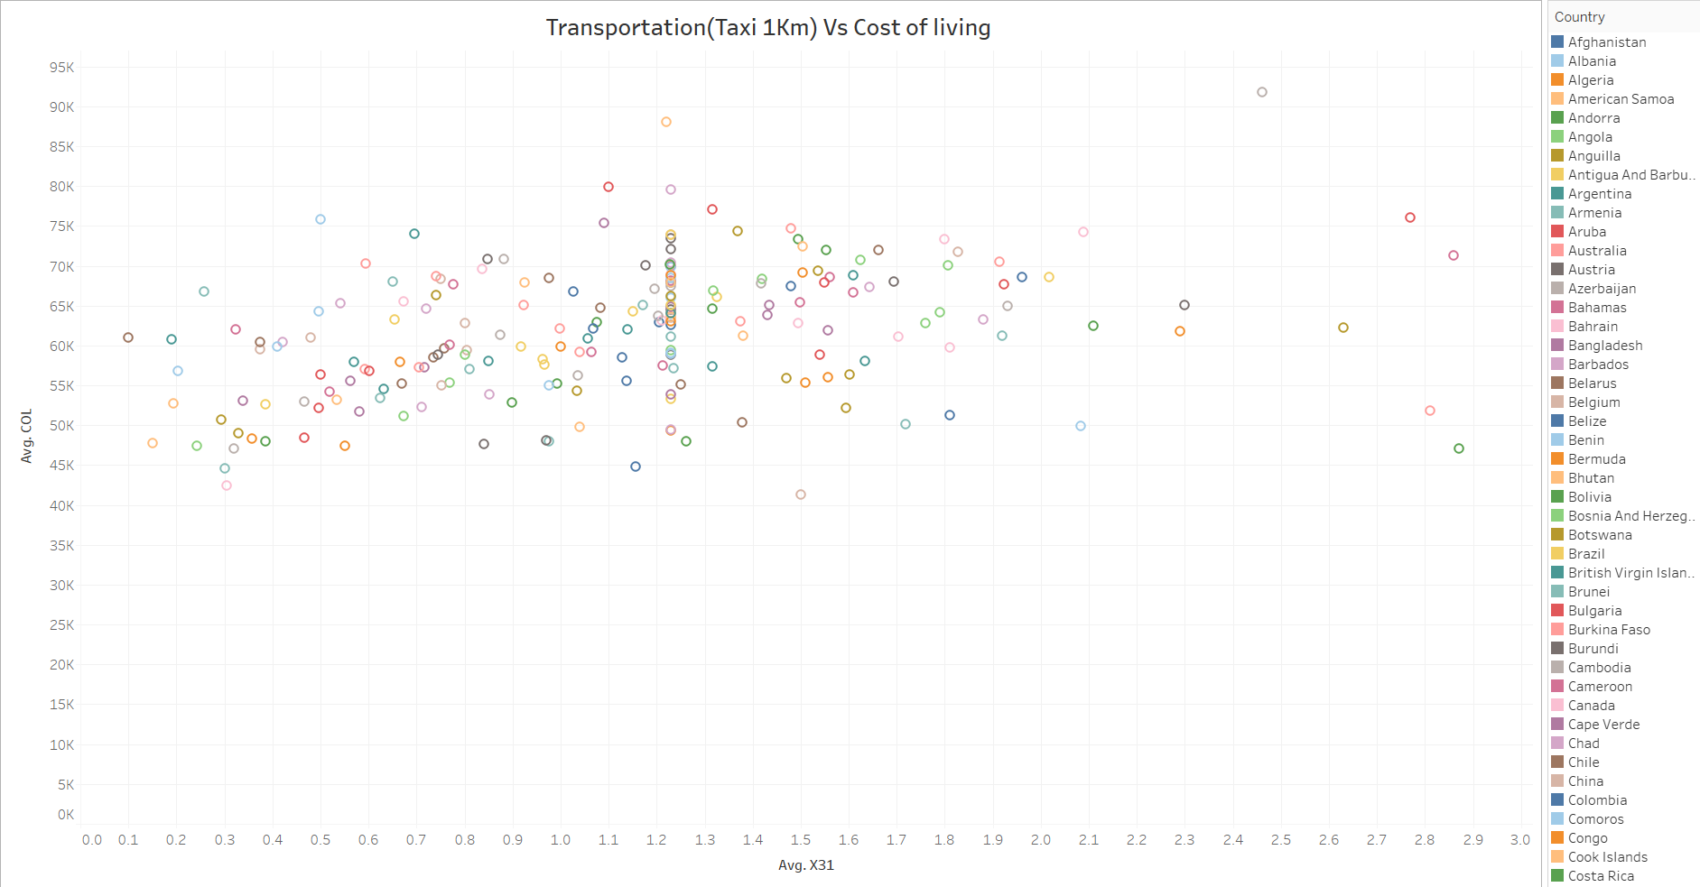
Correlation B/w Transportation with Taxi(1 Km) Vs Cost Of Living

Slide 9
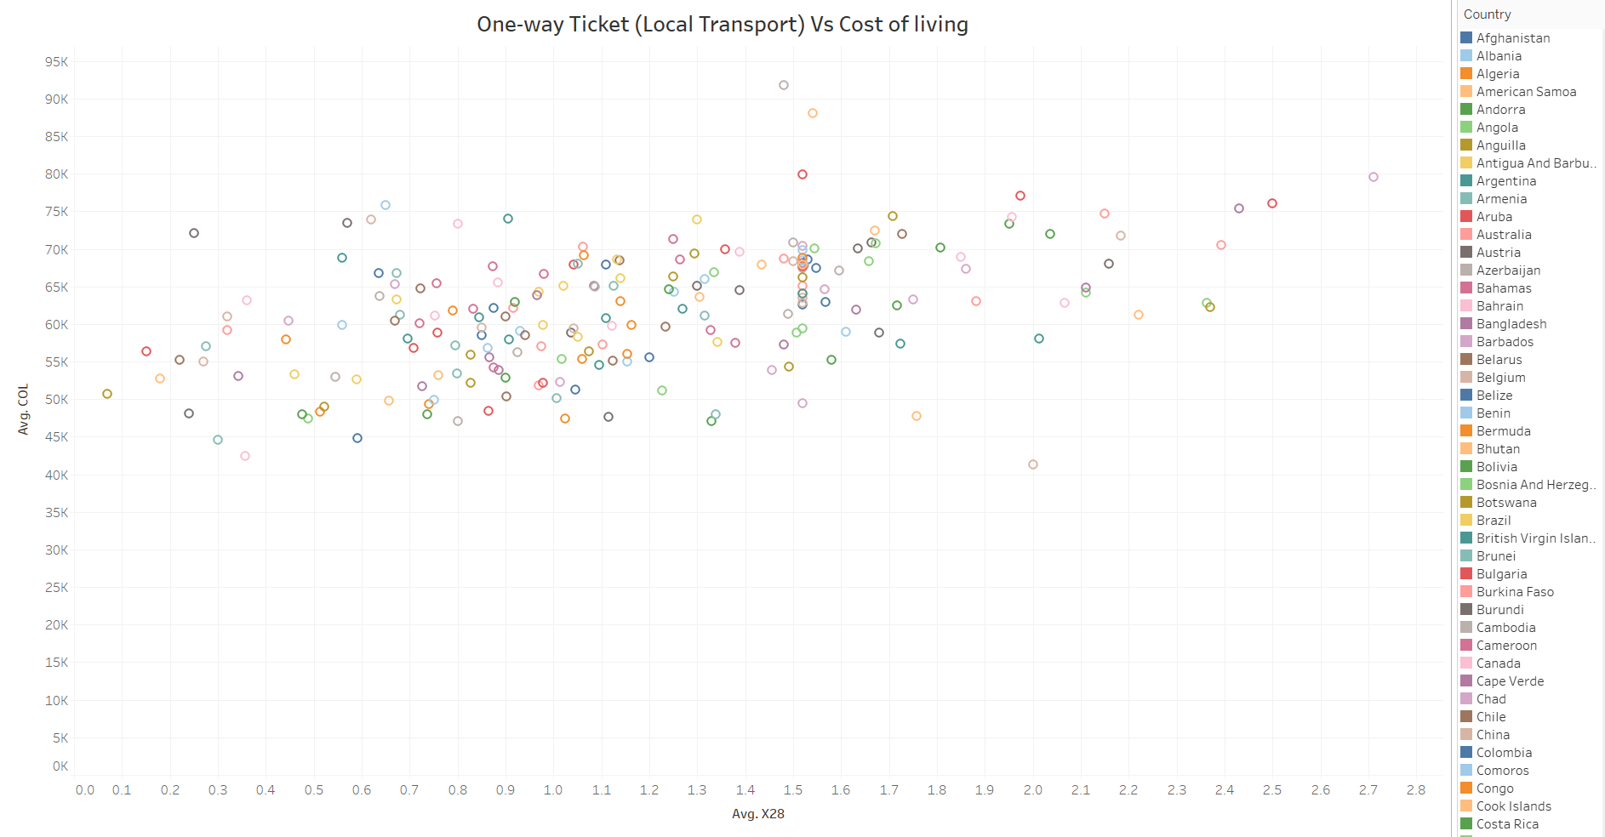
One-Way(Local Transportation) Vs Cost Of Living

Slide 10
Thank You

